Slide 1


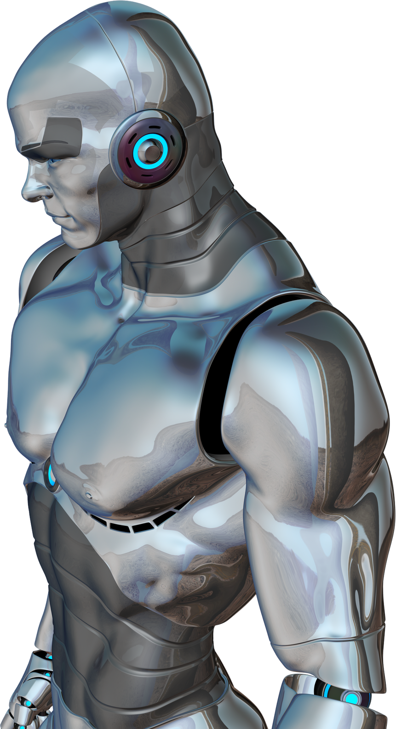
WELCOME TO MY AI COURSE
JOURNEY!

Slide 2

THEORY OVERVIEW
IThis course covered core AI concepts including Constraint Satisfaction Problems, Propositional and Predicate Logic, Search Algorithms like BFS, DFS, A*, and AO*, and Reasoning under Uncertainty using Bayesian Networks and Fuzzy Logic.I also explored NLP with N-Gram models and POS tagging, Information Retrieval using Bag-of-Words, supervised and unsupervised learning techniques, as well as robotics and semantic representations like frames and scripts.

Slide 3
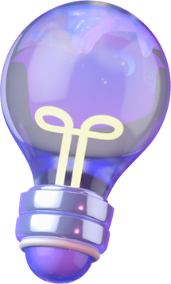
LAB WORK INTRO
In the lab, I applied AI techniques to build real projects and games, implementing algorithms like AO Star, BFS, Minimax, Alpha-Beta Pruning, Bidirectional Search, Depth-Limited Search, and more.

Slide 4

GAMES IMPLEMENTED
I developed Tic Tac Toe with Minimax, Connect Four using Alpha-Beta Pruning, a Take Away game with recursive AI logic, and a Chess game built using the python-chess library powered by Minimax and Alpha-Beta pruning.

Slide 5
CHESS - PROJECT
I developed a full Chess game using the python-chess library. The AI opponent uses Minimax with Alpha-Beta pruning to simulate intelligent decision-making and plan ahead several moves. This approach allows the computer to evaluate many possible moves efficiently and choose the best strategy, making the game challenging and realistic.

Slide 6
TIC TAC TOE - PROJECT
I developed a Tic Tac Toe game where the AI uses the Minimax algorithm to always play optimally and block the opponent’s winning moves. The AI evaluates all possible future moves to choose the best strategy, ensuring it never loses. This project helped me understand recursive decision-making and the power of search algorithms in game AI.

Slide 7
CONNECT FOUR - PROJECT
In the Connect Four game, I used Alpha-Beta Pruning with Minimax to make the AI play smartly, reducing unnecessary computations and improving speed. The AI looks ahead several moves, blocks threats, and aims to create four in a row. This project taught me how pruning makes decision-making more efficient in complex games with larger search spaces.

Slide 8
AI APPLICATIONS IN THE REAL WORLD
Through this course, I learned how the same AI techniques used in games can also power real-world systems. Algorithms like Minimax, Alpha-Beta Pruning, and search strategies help robots plan actions, navigate environments, and make intelligent decisions under uncertainty. From smart assistants to autonomous systems, AI is shaping the future — and this course helped me take my first step into that world.

Slide 9
Conclusion
This AI course was a complete journey through both foundational theories and practical applications. I learned how intelligent systems reason, plan, and make decisions using algorithms like Minimax, Alpha-Beta Pruning, and CSP solving techniques. Applying these concepts in real projects like Tic Tac Toe, Connect Four, and Mini Chess helped me connect theory with hands-on experience. Overall, the course enhanced my problem-solving skills and gave me a solid base for building intelligent systems in the future.

Slide 10
THANK YOU!
FOR YOUR ATTENTION

